Slide 1
Limit Order Flow, Market Impact and Optimal Order
http://sfb649.wiwi.hu-berlin.de/papers/pdf/SFB649DP2011-056.pdf
Stefan Duprey
Notes:
The goal :
To give you new empirical evidence on order submission activity and
price impacts of limit orders at NASDAQ.
We propose a method to predict the optimal size of a limit order conditional on
its position in the book and a given fixed level of expected market impact.

Slide 2
Electronic limit order book systems are the dominant trading form
NASDAQ, NYSE, BATS, EURONEXT
They bring :
Transparency
Low latency
High liquidity
Low trading costs
Notes:
Transparency, low latency, high liquidity and low trading costs attract
an increasing number of intraday traders, long-horizon traders as well as institutional
investors.
Though electronic limit order book trading already exists for many years,
further developments in trading systems and structures are ongoing and are faster
than ever before. The successive automatization of order management and execution
by computer algorithms, the growing importance of smart order routing as well as
changes of market structures and trading forms challenge empirical and theoretical
market microstructure research.
During the continuous trading period between 9:30
and 16:00 EST, limit orders are submitted to a centralized computer system where they
are matched to prevailing limit or hidden orders on the opposite side. If there is no
match or the standing volume in the system is insufficient to fully execute the incoming
order, the remaining order volume is placed in the order book. NASDAQ supports
various order types like pure market orders (immediate order execution without a price
limit), stop orders (automatic issuing of limit orders or market orders when a given
price is reached), immediate-or-cancel (IOC) orders, reserve orders and non-display
orders, among others.

Slide 3
Total View ITCH data : data directly stemming from NASDAQ
Limit order submission
Cancellation
Execution
We can reconstruct the order book at any time
Notes:
TotalView-ITCH data contains all order messages and thus allows us to reconstruct
the NASDAQ limit order book in a very precise way, particularly accounting for all
high-frequency limit order activities including also so-called fleeting orders.
we can exactly reconstruct the order book at any time by aggregating
the existing visible limit orders according to their limit prices.
Hence, the reconstructed
order book exactly represents historical real-time-disseminated order book
states. Trades are identified via the records of limit orders and hidden order executions.
Since the trading direction of limit orders and hidden orders is recorded, we can exactly
identify whether a trade is buyer-initiated or seller-initiated. Finally, TotalView-ITCH
data records a unique identification of any limit order
Note that a market order, especially when its order size is comparably large, is
likely to be filled by several pending limit orders. This results in multiple limit order
executions corresponding to a sequence of same-type (sub-)trades within a short time
interval. We identify transactions as sub-trades if they occur in less than half a second
after the previous trade and have the same initiation types. All corresponding subtrades
are consolidated to a single trade representing a market order.

Slide 4
Major order flow and order book characteristics
Huge number of limit orders at round lot
Most limit orders outside the spread
Only very few limit orders are executed.
Notes:
Empirical evidence :
(i) Market participants submit a huge number of limit orders with small sizes. The
average limit order size is approximately 156 shares (a round lot is 100).
the number of limit order submissions
is twenty to forty higher than the number of trades.
(ii) Most of the limit orders are posted at or behind the market. We observe that
only approximately 8.2% of the limit orders are placed within the spread and
thus update the best quotes.
(iii) Only few limit orders are executed. The average execution time across the ten
stocks is approximately 7 seconds. However, the volume-weighted average execution
time is substantially greater than its median, reflecting the fact that large
limit orders face significantly higher execution risk than small orders.
(iv) More than 95% of limit orders are cancelled without (partial) execution. The
median cancellation time of aggressive limit orders placed inside of the spread
is less than one second. Hasbrouck and Saar (2009) argue that such a high
cancellation rate of limit orders at NASDAQ mainly results from traders ’pinging’
for hidden liquidity in the market.

Slide 5
How to estimate the market impact of a limit order
Avoid Revelation of trading intention
Iceberg order to liquidate big order
Quantify trading friction for any strategy
Notes:
Of particular interest is whether the
magnitudes of price impacts identified in other markets are also found in the extremely
liquid NASDAQ market and which limit order sizes can be ultimately posted without
significantly moving the market.
Our empirical results show that the shortrun
and long-run quote reaction patterns after the arrival of a limit order are indeed
quite similar to those, for example found for Euronext Amsterdam (see Hautsch and
Huang 2009). Buy (sell) limit orders cause permanent quote increases (decreases) and
a temporary decline of the spread. Moreover, we find that the permanent impact of
a limit order posted at the best quote is in most cases approximately 25% of that of
a trade of similar size. However, this magnitude can be much smaller when hidden
orders are placed inside of the spread. As on other liquid markets, only aggressive limit
orders posted on the first or second order level induce significant price impacts whereas
orders posted with greater distance to the market have virtually no effect

Slide 6
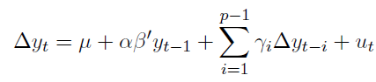
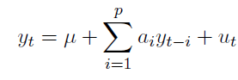
A cointegrated VAR model for the Limit Order Book
Cointegrated Vector Error Correction model
Corresponding reduced VAR model
Notes:
Denote t as a (business) time index, indicating all order book activities, i.e., incoming
limit or market orders as well as limit order cancellations.
Furthermore, pa
and pb
denote the best log ask and bid quotes instantaneously after the last t order activity
and va,j
t and vb,j
t , j = 1, . . . , k, define the log depth on the j matching best observed quote
level on the ask and bid side, respectively.
Moreover, to capture dynamic interactions
between limit order and market order activities, we define two dummy variables, BUYt
and SELLt, indicating the occurrence of buy and sell trades.
Then, the resulting dimensional vector of endogenous variables is given by
The quote levels associated with va,j
t and vb,j
t are not observed on a fixed grid at and behind
the best quotes. Consequently, their price distance to pa
t and pb
t is not necessarily
exactly j −1 ticks but might be higher if there are no limit orders on all possible intermediate
price levels behind the market.
However, from empirical evidence, we know that trades “walking
through the book”, i.e., trades absorbing more than one price level in the limit order
book occur extremely rarely.
Consequently, we expect that an augmentation of the
system by the inclusion of level-specific limit prices does not provide significantly additional
information but just increases the dimension and the complexity of the system.
Note that market depth enters the vector yt in levels and thus is treated as a possibly
non-stationary variable. Since market depth is highly persistent and (on very high
frequencies) reveals features of a near-unit-root process
So we recommend treating this variable as being possibly non-stationary. This guarantees
consistency of estimates, even if market depth is truly stationary.
U_t : white noise
Alpha : loading
Beta : cointegrating relations

Slide 7
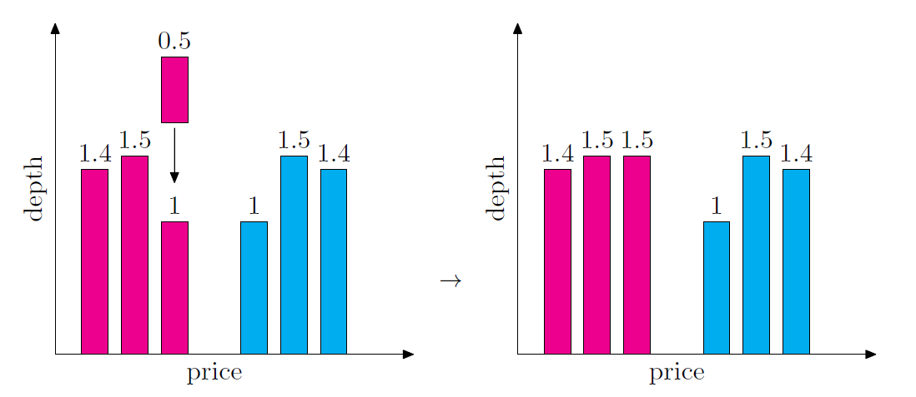
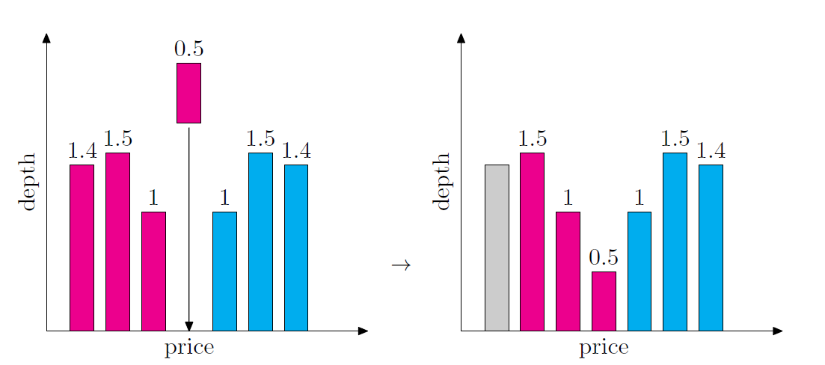
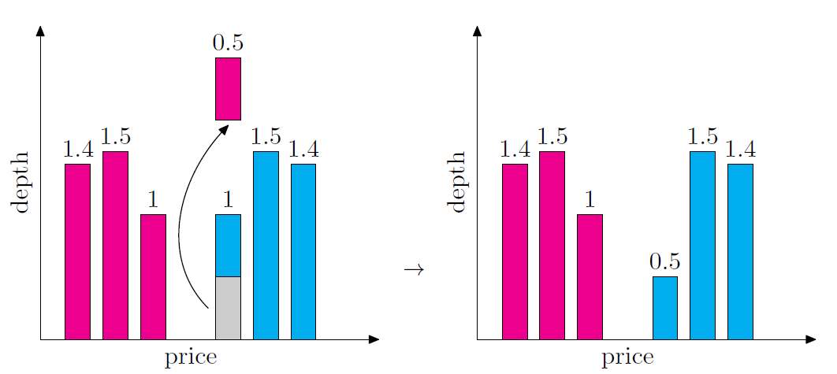
Estimating market impact : 3 scenarii
Normal passive Limit Order
Aggressive Limit Order
Normal Market Order

Slide 8
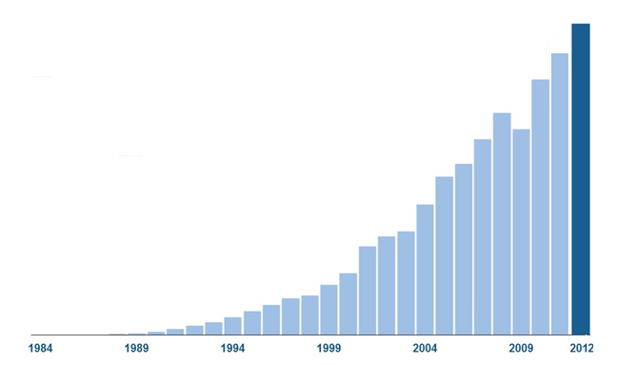

Why MATLAB ?

Slide 9


Slide 10
Language
Of
Technical
Computing
O
Data Mining
Business
Intelligence
Signal
Processing
Quantitative
Finance
Software
Platform
Development
Image Video
Data
Acquisition

Slide 11

Not everybody
would use
MATLAB

Slide 12

In an innovative enterprise,
each one should have access
to MATLAB based applications

Slide 13
Share
your MATLAB algorithms within your enterprise ecosystem

Slide 14
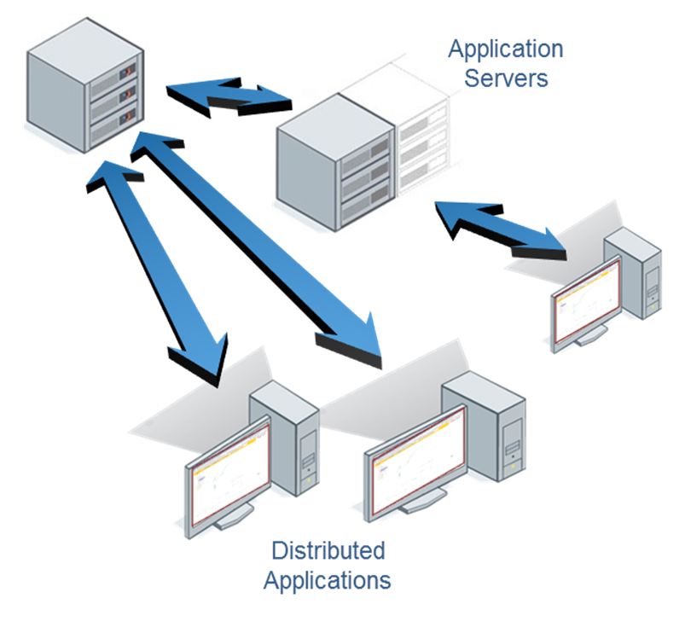






Notes:
MATLAB Production Server lets you run MATLAB programs within your production IT systems, enabling you to incorporate numerical analytics in enterprise IT applications.
Web, database, and enterprise IT applications connect to MATLAB programs running on MATLAB Production Server via a lightweight client library, isolating the MATLAB programs from your production IT system.
Use MATLAB Compiler to package MATLAB programs and deploy them directly to MATLAB Production Server without recoding or creating custom infrastructure to manage them.
MATLAB Production Server runs on multiprocessor and multicore servers, providing low-latency processing of large numbers of concurrent requests. You can deploy the product on additional computer servers to increase the number of concurrent requests the system can handle and to provide redundancy.
The client library supports .NET and Java environments so MATLAB programs running on MATLAB Production Server can be accessed by any application supported by these development environments.

Slide 15
MATLAB Production Server
Directly deploy MATLAB programs into production
Scalable & reliable
Lightweight client
Notes:
MATLAB Production Server lets you run MATLAB programs within your production IT systems, enabling you to incorporate numerical analytics in enterprise IT applications.
Web, database, and enterprise IT applications connect to MATLAB programs running on MATLAB Production Server via a lightweight client library, isolating the MATLAB programs from your production IT system.
Use MATLAB Compiler to package MATLAB programs and deploy them directly to MATLAB Production Server without recoding or creating custom infrastructure to manage them.
MATLAB Production Server runs on multiprocessor and multicore servers, providing low-latency processing of large numbers of concurrent requests. You can deploy the product on additional computer servers to increase the number of concurrent requests the system can handle and to provide redundancy.
The client library supports .NET and Java environments so MATLAB programs running on MATLAB Production Server can be accessed by any application supported by these development environments.

Slide 16
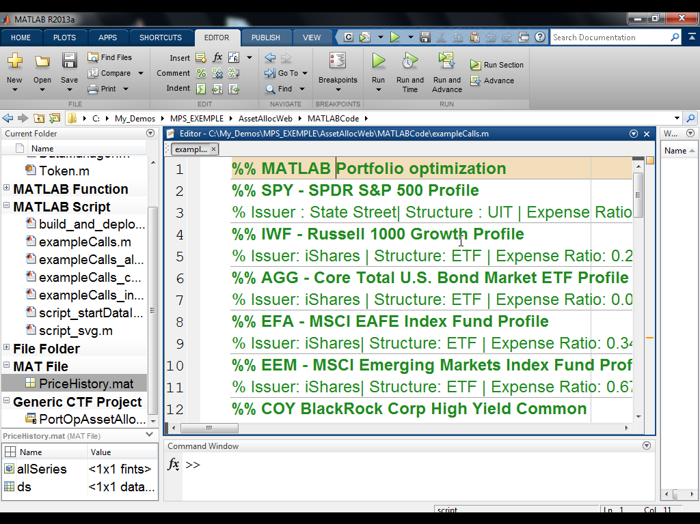
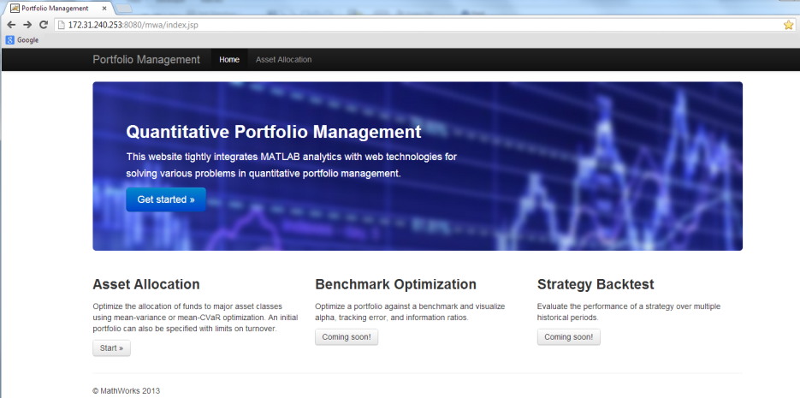
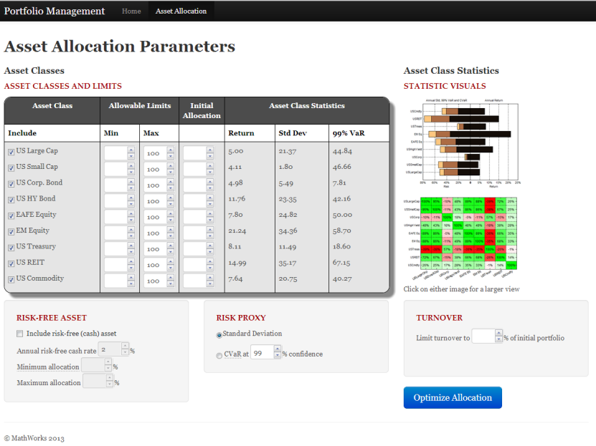
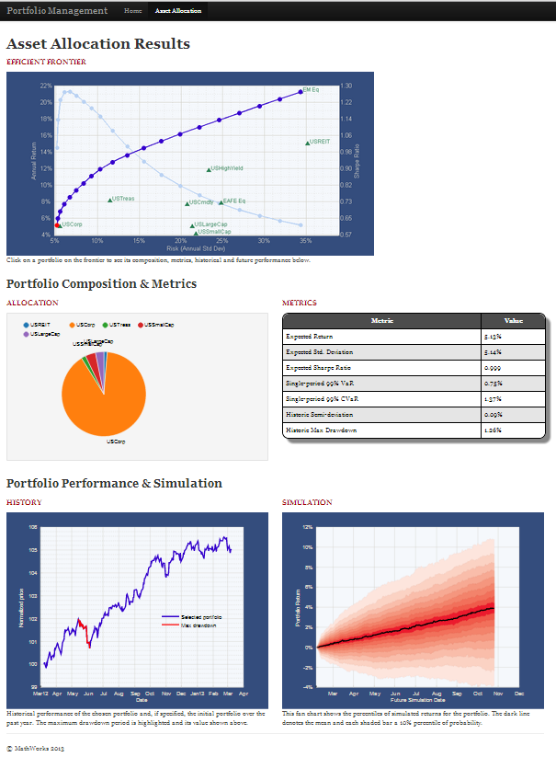
Enterprise Applications
Notes:
Choose a demo from the CRE
Demo can be found in CRE: query by “demo” and “matlab production server”

Slide 17

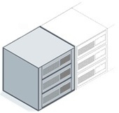


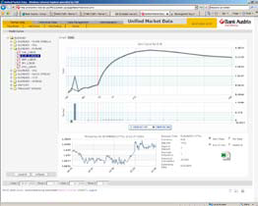




Challenges solved
Directly deploy MATLAB programs into production
Scalable & reliable
Lightweight client
MATLAB Production Server
Application Servers
Distributed
Applications
Notes:
MATLAB Production Server lets you run MATLAB programs within your production IT systems, enabling you to incorporate numerical analytics in enterprise IT applications.
Web, database, and enterprise IT applications connect to MATLAB programs running on MATLAB Production Server via a lightweight client library, isolating the MATLAB programs from your production IT system.
Use MATLAB Compiler to package MATLAB programs and deploy them directly to MATLAB Production Server without recoding or creating custom infrastructure to manage them.
MATLAB Production Server runs on multiprocessor and multicore servers, providing low-latency processing of large numbers of concurrent requests. You can deploy the product on additional computer servers to increase the number of concurrent requests the system can handle and to provide redundancy.
The client library supports .NET and Java environments so MATLAB programs running on MATLAB Production Server can be accessed by any application supported by these development environments.

Slide 18

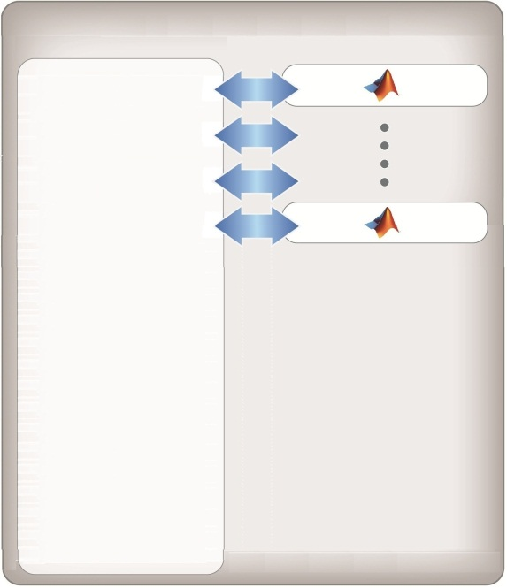

Integration with IT systems
MATLAB
Compiler
Web Applications
MATLAB Production Server
Web
Server
Portfolio
Optimization
Pricing
Desktop Applications
Application
Server
Risk
Analytics
Batch Applications
Database Server
Notes:
MATLAB Production Server provides a numerical backend for any number of IT systems or applications
Numerical algorithms can be deployed directly to MATLAB Production Server using MATLAB Compiler
Web servers (Apache Tomcat or Microsoft IIS) providing browser based content or web services (SOAP/REST) can directly request numerical processing from MATLAB Production Server
Databases which support these types of applications can also make calls for numerical processing initiated by database transactions using triggers and stored procedures
Desktop applications consisting of custom Java or .NET applications or standard applications such as Excel, where add-ins can be created to access numerical functions running on MATLAB Production Server
Server applications running in a batch mode can request numerical processing which may consist of MATLAB code accessing a data repository such as a SQL database or data historian

Slide 19

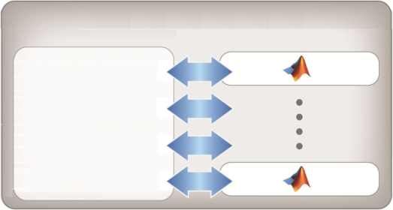

Client Library
Request MATLAB programs running on MATLAB Production Server
.NET and JAVA libraries available
MATLAB Production Server
Request Broker
&
Program Manager
.NET

Slide 20



Production Deployment Workflow
Development
MATLAB
Developer
Algorithm
MATLAB
Compiler
CTF
Enterprise
Application
Developer
Web
Application
MATLAB Production Server
Client
Library
Function Call
Production
MATLAB Production Server
Web
Application
.
.
.
Client
Library
Notes:
Here’s a typical example of how you can take an algorithm developed in MATLAB and integrate it into your production, enterprise application.
Consider a MATLAB developer who creates an algorithm.
(CLICK) Using the MATLAB Compiler, a deployable component is created as a CTF archive.
(CLICK) The CTF can be loaded within a local development MATLAB Production Server for testing
(CLICK) A Java or .NET client library – available as part of the MATLAB Production Server installation – integrates into the enterprise application and is used for making requests of the packaged MATLAB program running on MATLAB Production Server.
(CLICK) As you deploy this to production, the MATLAB Production Server is the numerical computation engine supporting the computational needs of the business application. The business application makes calls to the MATLAB Production Server in response to any MATLAB related processing that’s required to support user requests.
(Needs to be updated) How does the ML Production Server fit into the overall MATLAB “Research to Production” deployment workflow?
MATLAB is used as the research and development tool for creating and validating algorithms by such users as your Quantitative Analyst’s, Financial Engineers, Actuaries or Economists to name a few. (click)
Using the MATLAB compiler and Builder products, a deployable component is created along with a lightweight Java or .NET library. The Java or .NET library is provided to your Application Developers and easily integrated into your Business Application code. (click)
Looking at your production system, The ML Production Server is the numerical computation engine supporting the computational needs of your business application. Your business application will make calls to the ML Production Server in response to any MATLAB related processing that’s required to support user requests. (click)
Your business application is maintained within it’s own infrastructure (click) and the MATLAB components are easily managed and maintained within the reliable and scalable ML Production Server infrastructure. The ML Production Server provides for hot deployment of components and supports multiple versions of the MATLAB runtime (MCR) to support multiple MATLAB deployed components built on different platforms or versions of MATLAB.

Slide 21
Scaled Architecture
DMZ 1
DMZ 2
Web
Server
App
Server
Database Server
Web
Server
App
Server
Web
Server
App
Server
.
.
.
Web
Server
App
Server
Load Balancer
Load Balancer
Load Balancer
MATLAB Production Server
MATLAB Production Server
MATLAB Production Server
Request Broker
&
Program Manager
MATLAB Production Server
Request Broker
&
Program Manager
Request Broker
&
Program Manager
Request Broker
&
Program Manager
License
Manager
Auto Deployment
Repository

Slide 22
Integration Example
Reference client library
Define function signatures
Define connection (server & CTF)
MATLAB Function
function B = BlackScholes(CP,S,X,T,r,v)
d2=d1-v*sqrt(T);
if CP=='c'
B = (S*normcdf(d1)-X*exp(-r*T)*normcdf(d2))-noise;
Enterprise Application
using Mathworks.MATLAB.ProductionServer.Client;
public interface BlkSchInterface
{ double BlackScholes(string C, double S, double X, double T, double r, double v); }
MWClient client = new MWHttpClient();
BlkSchInterface blksch_1 = client.CreateProxy<BlkSchInterface>(new Uri("http://192.168.240.220:9910/BlkSch1"));
double optionprice = blksch_1.BlackScholes("c", BasePrice.Value, 1, 1, 1, Volatility.Value));

Slide 23
Integration with Databases
Optimize numerical processing within databases
Request MATLAB analytics directly from database servers
Trigger requests based upon database transactions
Minimize data handling using Database Toolbox
Database Server
MATLAB Production Server
Enterprise Application
Stored
Procedure
Client
Library
Request Broker
&
Program Manager
Notes:
MATLAB Production Server lets you run MATLAB programs within your production IT systems, enabling you to incorporate numerical analytics in enterprise IT applications.
Web, database, and enterprise IT applications connect to MATLAB programs running on MATLAB Production Server via a lightweight client library, isolating the MATLAB programs from your production IT system.
Use MATLAB Compiler to package MATLAB programs and deploy them directly to MATLAB Production Server without recoding or creating custom infrastructure to manage them.
MATLAB Production Server runs on multiprocessor and multicore servers, providing low-latency processing of large numbers of concurrent requests. You can deploy the product on additional computer servers to increase the number of concurrent requests the system can handle and to provide redundancy.
The client library supports .NET and Java environments so MATLAB programs running on MATLAB Production Server can be accessed by any application supported by these development environments.

Slide 24
Key Take-Aways
Enterprise solution
Be innovative
Cost saving
Quick time-to-market
Easy deployment
Notes:
MATLAB Production Server lets you run MATLAB programs within your production IT systems, enabling you to incorporate numerical analytics in enterprise IT applications.
Web, database, and enterprise IT applications connect to MATLAB programs running on MATLAB Production Server via a lightweight client library, isolating the MATLAB programs from your production IT system.
Use MATLAB Compiler to package MATLAB programs and deploy them directly to MATLAB Production Server without recoding or creating custom infrastructure to manage them.
MATLAB Production Server runs on multiprocessor and multicore servers, providing low-latency processing of large numbers of concurrent requests. You can deploy the product on additional computer servers to increase the number of concurrent requests the system can handle and to provide redundancy.
The client library supports .NET and Java environments so MATLAB programs running on MATLAB Production Server can be accessed by any application supported by these development environments.

Slide 25
Thank You

Slide 26

MATLAB and Simulink are registered trademarks of The MathWorks, Inc. See www.mathworks.com/trademarks for a list of additional trademarks.
Other product or brand names may be trademarks or registered trademarks of their respective holders.”

